Slide 1
Remember to clean up your resource groups!
Each of the labs explains the best way to clean up the resources that were created so you are not charged for them. Please be sure to complete those clean up tasks.
https://aka.ms/azuredevdaylabs

Slide 2
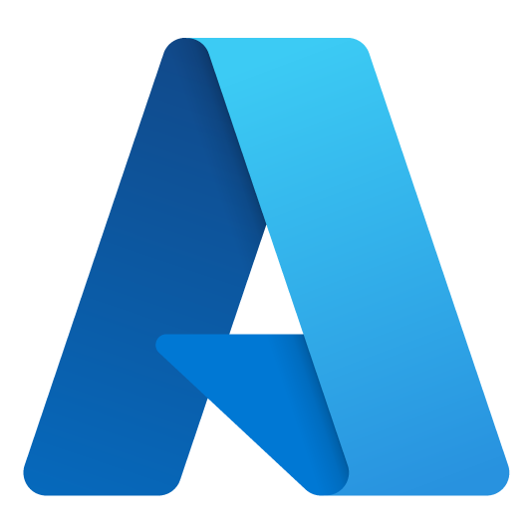
Next Steps
Reach out to your Microsoft team
Additional training courses
Architectural design sessions
Microsoft Learn
Azure Architecture Center
Azure Open Hack
Azure Dev Day

Slide 3
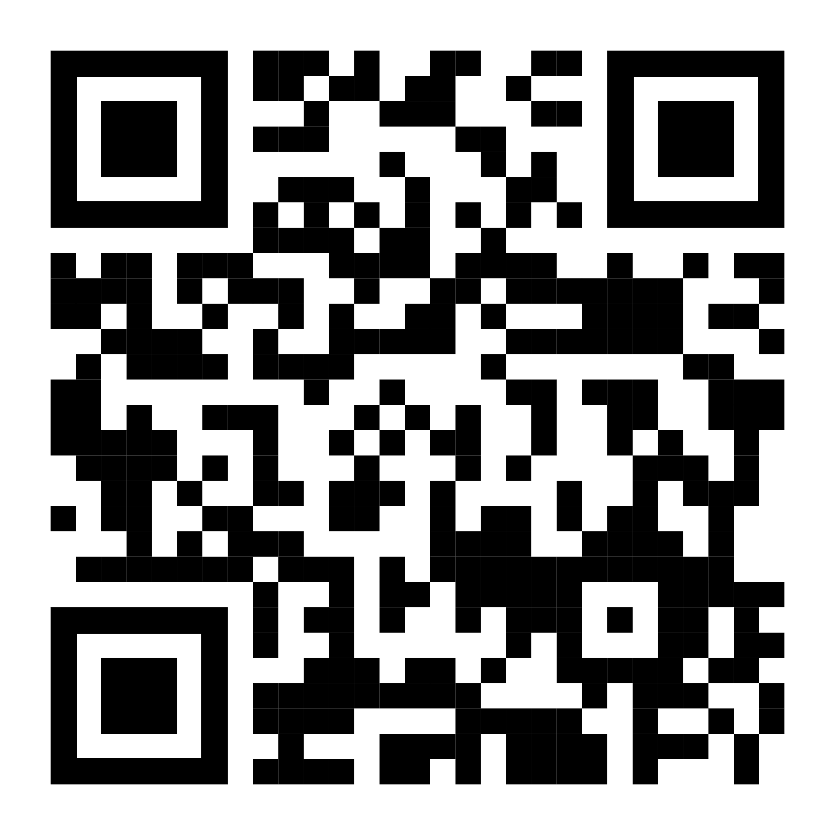
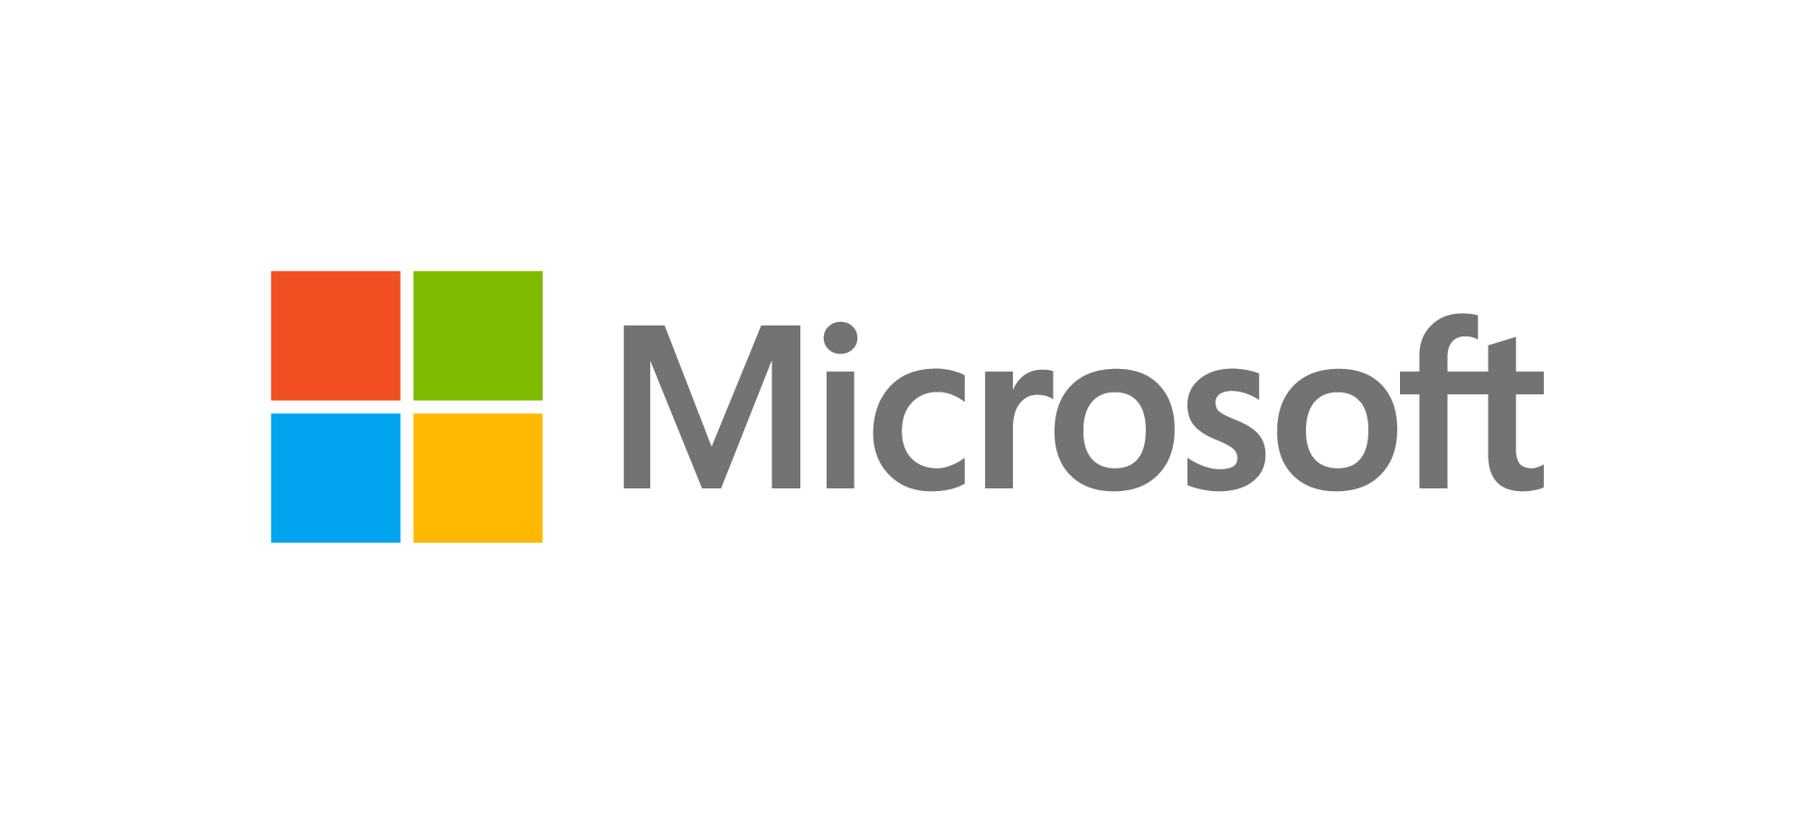
Sign up for Microsoft.Source
Thank you!
Receive a regular digest of relevant technical content, events and training
Get the best of the newest resources, tools and guidance to help developers quickly build and deploy on Azure
Please fill out the Azure Dev Day Survey!
aka.ms/azuredevdaysurvey
And visit our event content page to access lab materials, presentations and more about the Microsoft Build Conference!
aka.ms/azuredevdaycontent
Get the latest articles, documentation, and events from Microsoft.Source—the curated monthly developer community newsletter.
Stay at the forefront of rapidly evolving technologies with resources that are relevant to your field, location, and areas of interest—including articles, GitHub repositories, and how-to guides.
Get notified about events—from local hacks, workshops, and training sessions to virtual meetups and global conferences.
Learn what you want, when you want, how you want. Resources include in-person hands-on workshops, free, interactive online training and sandbox environments.

